Slide 1

Home automation using Google Assistant and Nodemcu
DAY 29
EMBEDDED SYSTEM DESIGN & IoT-Master Class

Slide 2
What You will learn Today?
What is blynk app
Home automation using NodeMCU and Google Assistant

Slide 3
Mindset Lesson for the Day
Never complain.

Slide 4
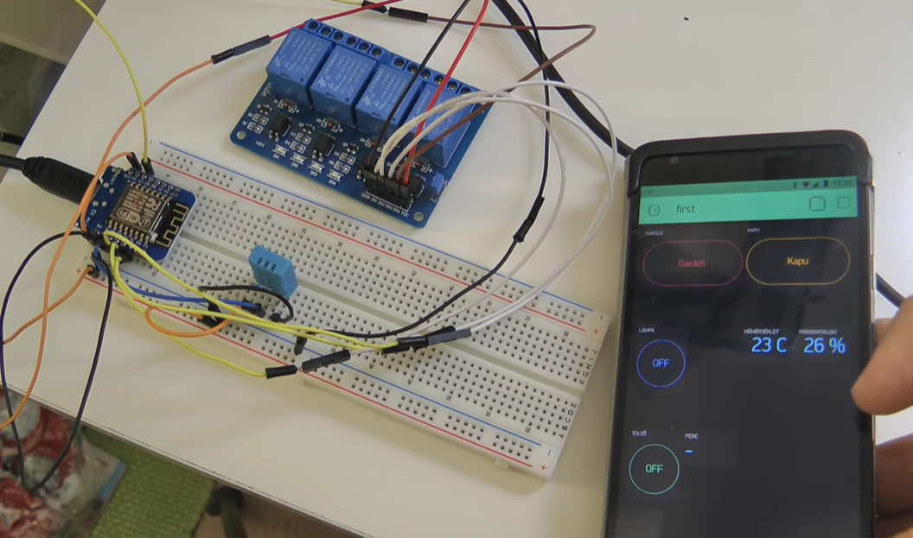
Home automation using NodeMCU and Google assistant

Slide 5
HARDWARE REQUIREMENTS
NodeMCU
Relay
Light bulb

Slide 6
SOFTWARE REQUIREMENTS
Arduino IDE
Blynk app
IFTTT

Slide 7
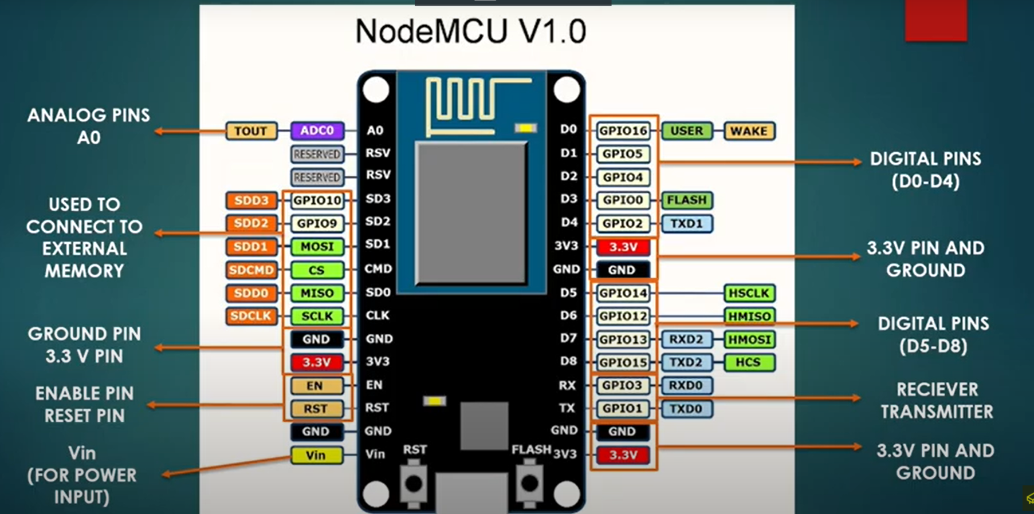
Node MCU V 1.0

Slide 8
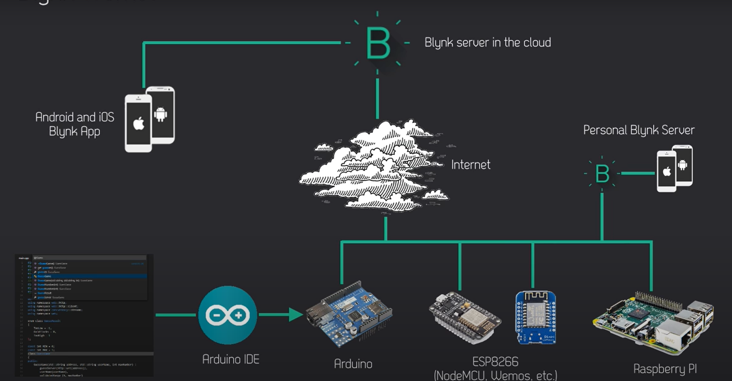
How Blynk works

Slide 9
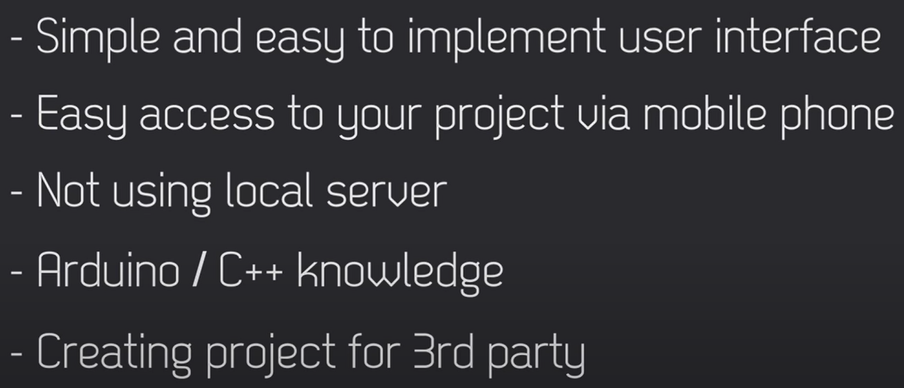
When to use Blynk

Slide 10
What is an IFTTT
IFTTT derives its name from the programming conditional statement “if this, then that.”
What the company provides is a software platform that connects apps, devices and services from different developers in order to trigger one or more automations involving those apps, devices and services.

Slide 11
DEMO

Slide 12
Thank You

